Slide 1
An Introduction to Susquehanna

Slide 2
Who We Are
In the early 1980s, a group of friends from college began trading independently on the floor of the Philadelphia Stock Exchange. They used their quantitative skills and poker experience to build successful trading strategies in the financial markets. Realizing that they could be more successful working collaboratively, the founders joined together in 1987 to start what is now Susquehanna International Group.
Today, Susquehanna has over 3,000 employees in our offices around the globe. While we have grown in size and expanded our reach, our collaborative culture and love for gaming remains.

Slide 3
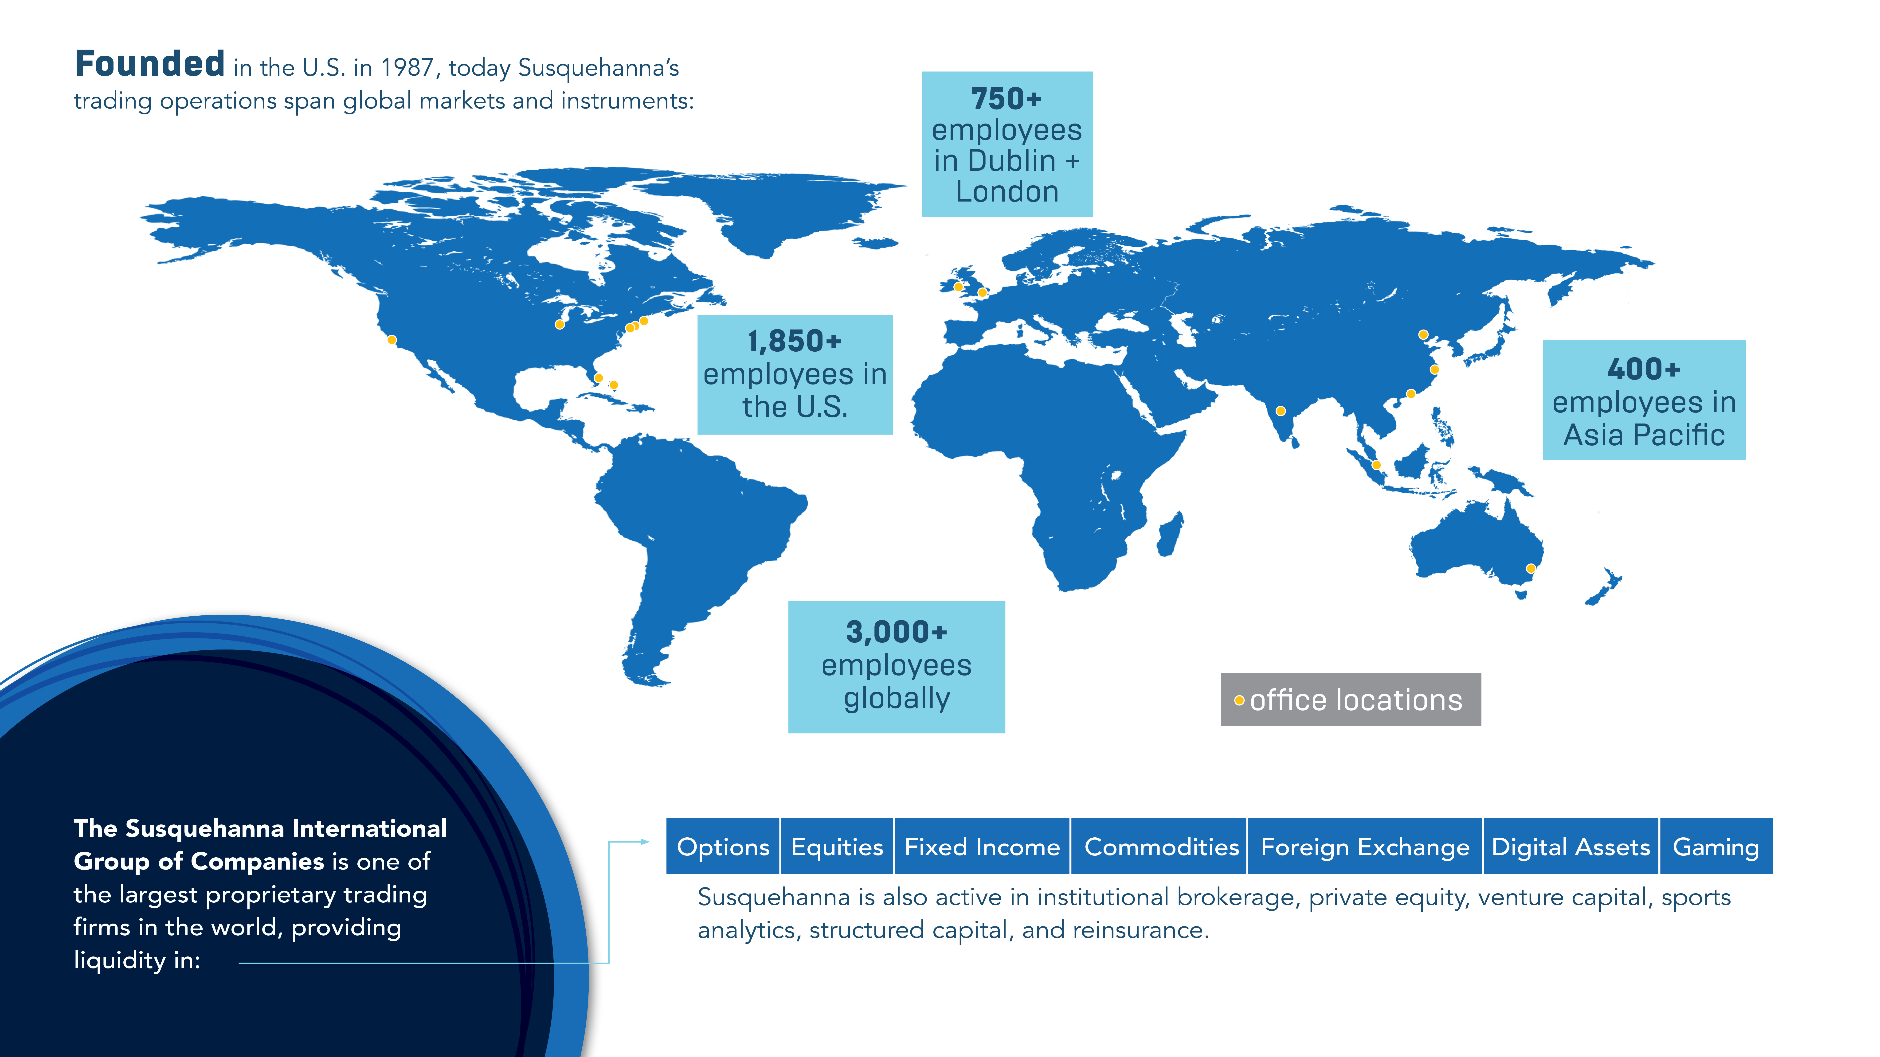

Slide 4
What We Do
Susquehanna’s deep integration of trading, technology, and quant research makes us experts in trading essentially all listed financial products and asset classes, with a focus on derivatives. We handle millions of trading transactions around the world every day as both a market maker and market taker. Our efforts provide liquidity and ensure competitive prices for buyers and sellers. While our presence in the market is broad, our trading desks are highly specialized to allow for a deep understanding of the unique drivers of each asset class.

Slide 5
Opportunities
Candidate Eligibility for Students
INTERNSHIPS: Take place over the summer. Students must be graduating in the year following their internship and ready to start full-time by the following summer.
FULL-TIME/NEW GRAD: For students approaching graduation
DISCOVERY DAYS: For students not yet eligible for internships
Campus Career Opportunities
CAMPUS OPPORTUNITIES: Trading, Quant, Technology, Equity/Macro Research, Growth Equity/Private Equity, ETF Sales, Compliance, Derivative Sales, and Operations/Accounting/Tax
MAIN OFFICES FOR CAMPUS ROLES: Bala, New York, Chicago, Dublin, and Sydney
SIG.COM/CAREERS: Check out up-to-date career opportunities
We sponsor and attend high school events and competitions. We also host virtual high school Discovery Days.

Slide 6
Interview Process
Our interview process is designed for candidates to get to know us, and for us to get to know them. Throughout the process, Susquehanna employees will assess candidates to find the role that’s best aligned to their skillset. At the same time, candidates will have opportunity at each stage to learn about our environment and whether it’s the place for them.
1.
First step for most is online assessment - coding exercise or quantitative questions
Most roles will then have a recruiter screen, followed by phone or video interviews with people who work closely with the role, culminating in a final round interview with hiring managers.
2.
3.
Most but not all final rounds are conducted in the Susquehanna office.

Slide 7

sig.com

