Slide 1
An Introduction to Susquehanna

Slide 2
Who We Are
In the early 1980s, a group of friends from college began trading independently on the floor of the Philadelphia Stock Exchange. They used their quantitative skills and poker experience to build successful trading strategies in the financial markets. Realizing that they could be more successful working collaboratively, the founders joined together in 1987 to start what is now Susquehanna International Group.
Today, Susquehanna has over 3,000 employees in our offices around the globe. While we have grown in size and expanded our reach, our collaborative culture and love for gaming remains.

Slide 3
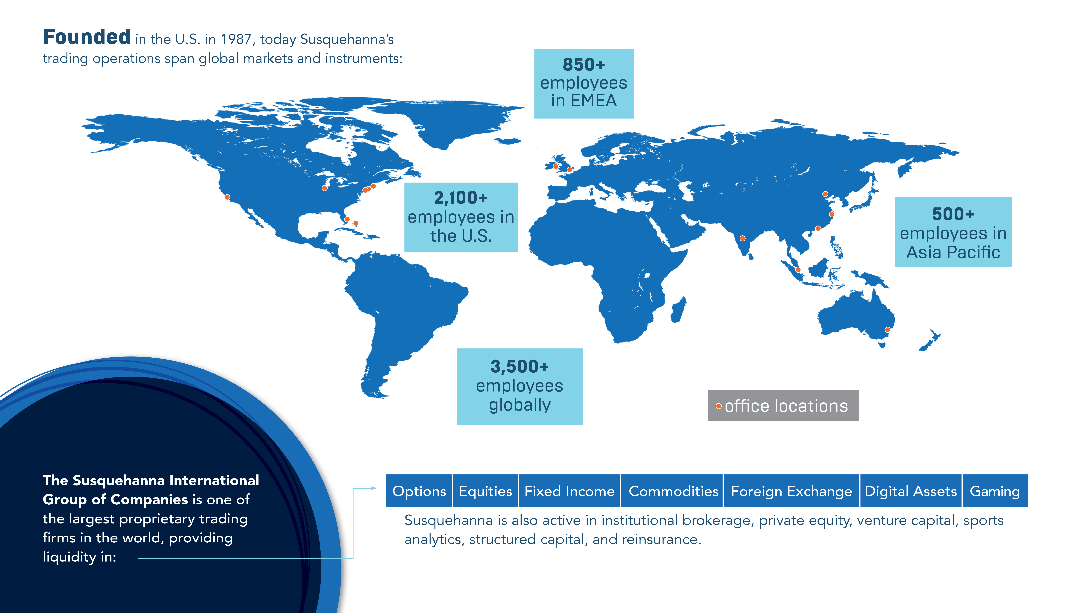

Slide 4
What We Do
Susquehanna’s deep integration of trading, technology, and quant research makes us experts in trading essentially all listed financial products and asset classes, with a focus on derivatives. We handle millions of trading transactions around the world every day as both a market maker and market taker. Our efforts provide liquidity and ensure competitive prices for buyers and sellers. While our presence in the market is broad, our trading desks are highly specialized to allow for a deep understanding of the unique drivers of each asset class.

Slide 5
Opportunities
INTERNSHIP PROGRAMS: Our 10-week program runs from late November to early February.
GRADUATE PROGRAMS: For students a year out from graduation
Roles
Quantitative Trader
Operations Analyst
Equity/Macro Research
Software Developer
Quantitative Research
Quantitative Systematic Trader
Degrees We Hire
Actuarial Studies
Computer Science
Economics
Engineering
Finance
Maths
Medicine
Physics
Statistics
+more

Slide 6
Early Talent Programs + Events
Explore the world of trading, technology, and finance through immersive programs designed to help you discover your path.
  Women’s Discovery Program: A day long program for women and female-identifying students from any academic year. Attendees will gain an inside look at our culture and hear directly from the women who found their path and built meaningful careers.
  First Year Discovery Program: A short virtual program designed for first-year students to build a foundational understanding of the trading industry, Susquehanna, and career pathways.
  Pre-penultimate Discovery Programs: Attendees apply for a specific track, to ensure they get a day filled with the content that matters most to them. This program offers an in-depth look at Susquehanna and our roles through immersive lectures, interactive sessions, and meaningful networking. Participants get insight and exposure to next year’s internship interview process.
Events
Brainteaser
Battles
Panel Discussions
Poker
Tournaments
Algothon
Case Studies
Career Fairs

Slide 7
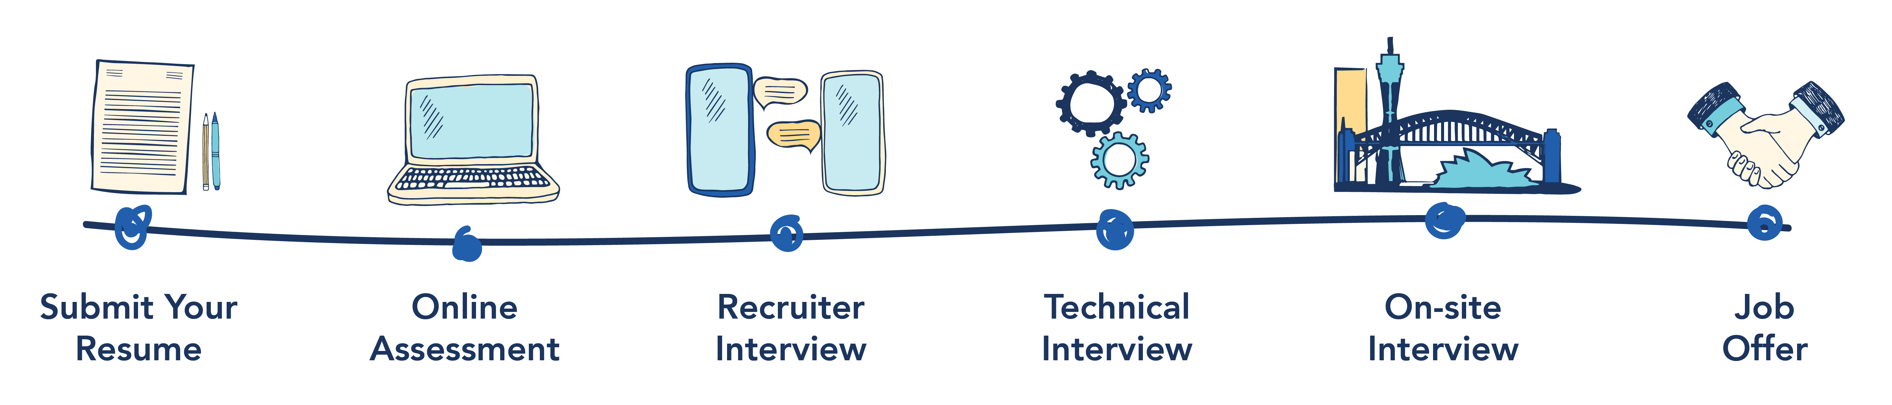
Interview Process
Notes:
You are here
Trading: day 3 is an interview – we will get into that and our goal is to get you to offer status after discovery day if we need to assess additional itms youmight need anadditional technical screen
Tech : Technical interview and on
Research: Technical interview on
Quant?

Slide 8

sig.com

